Slide 1
"Preparation for Life and Eat for Chinese Students in Northeastern University"
许恒嘉 谢宇豪
AP Statastic
Section6

Slide 2
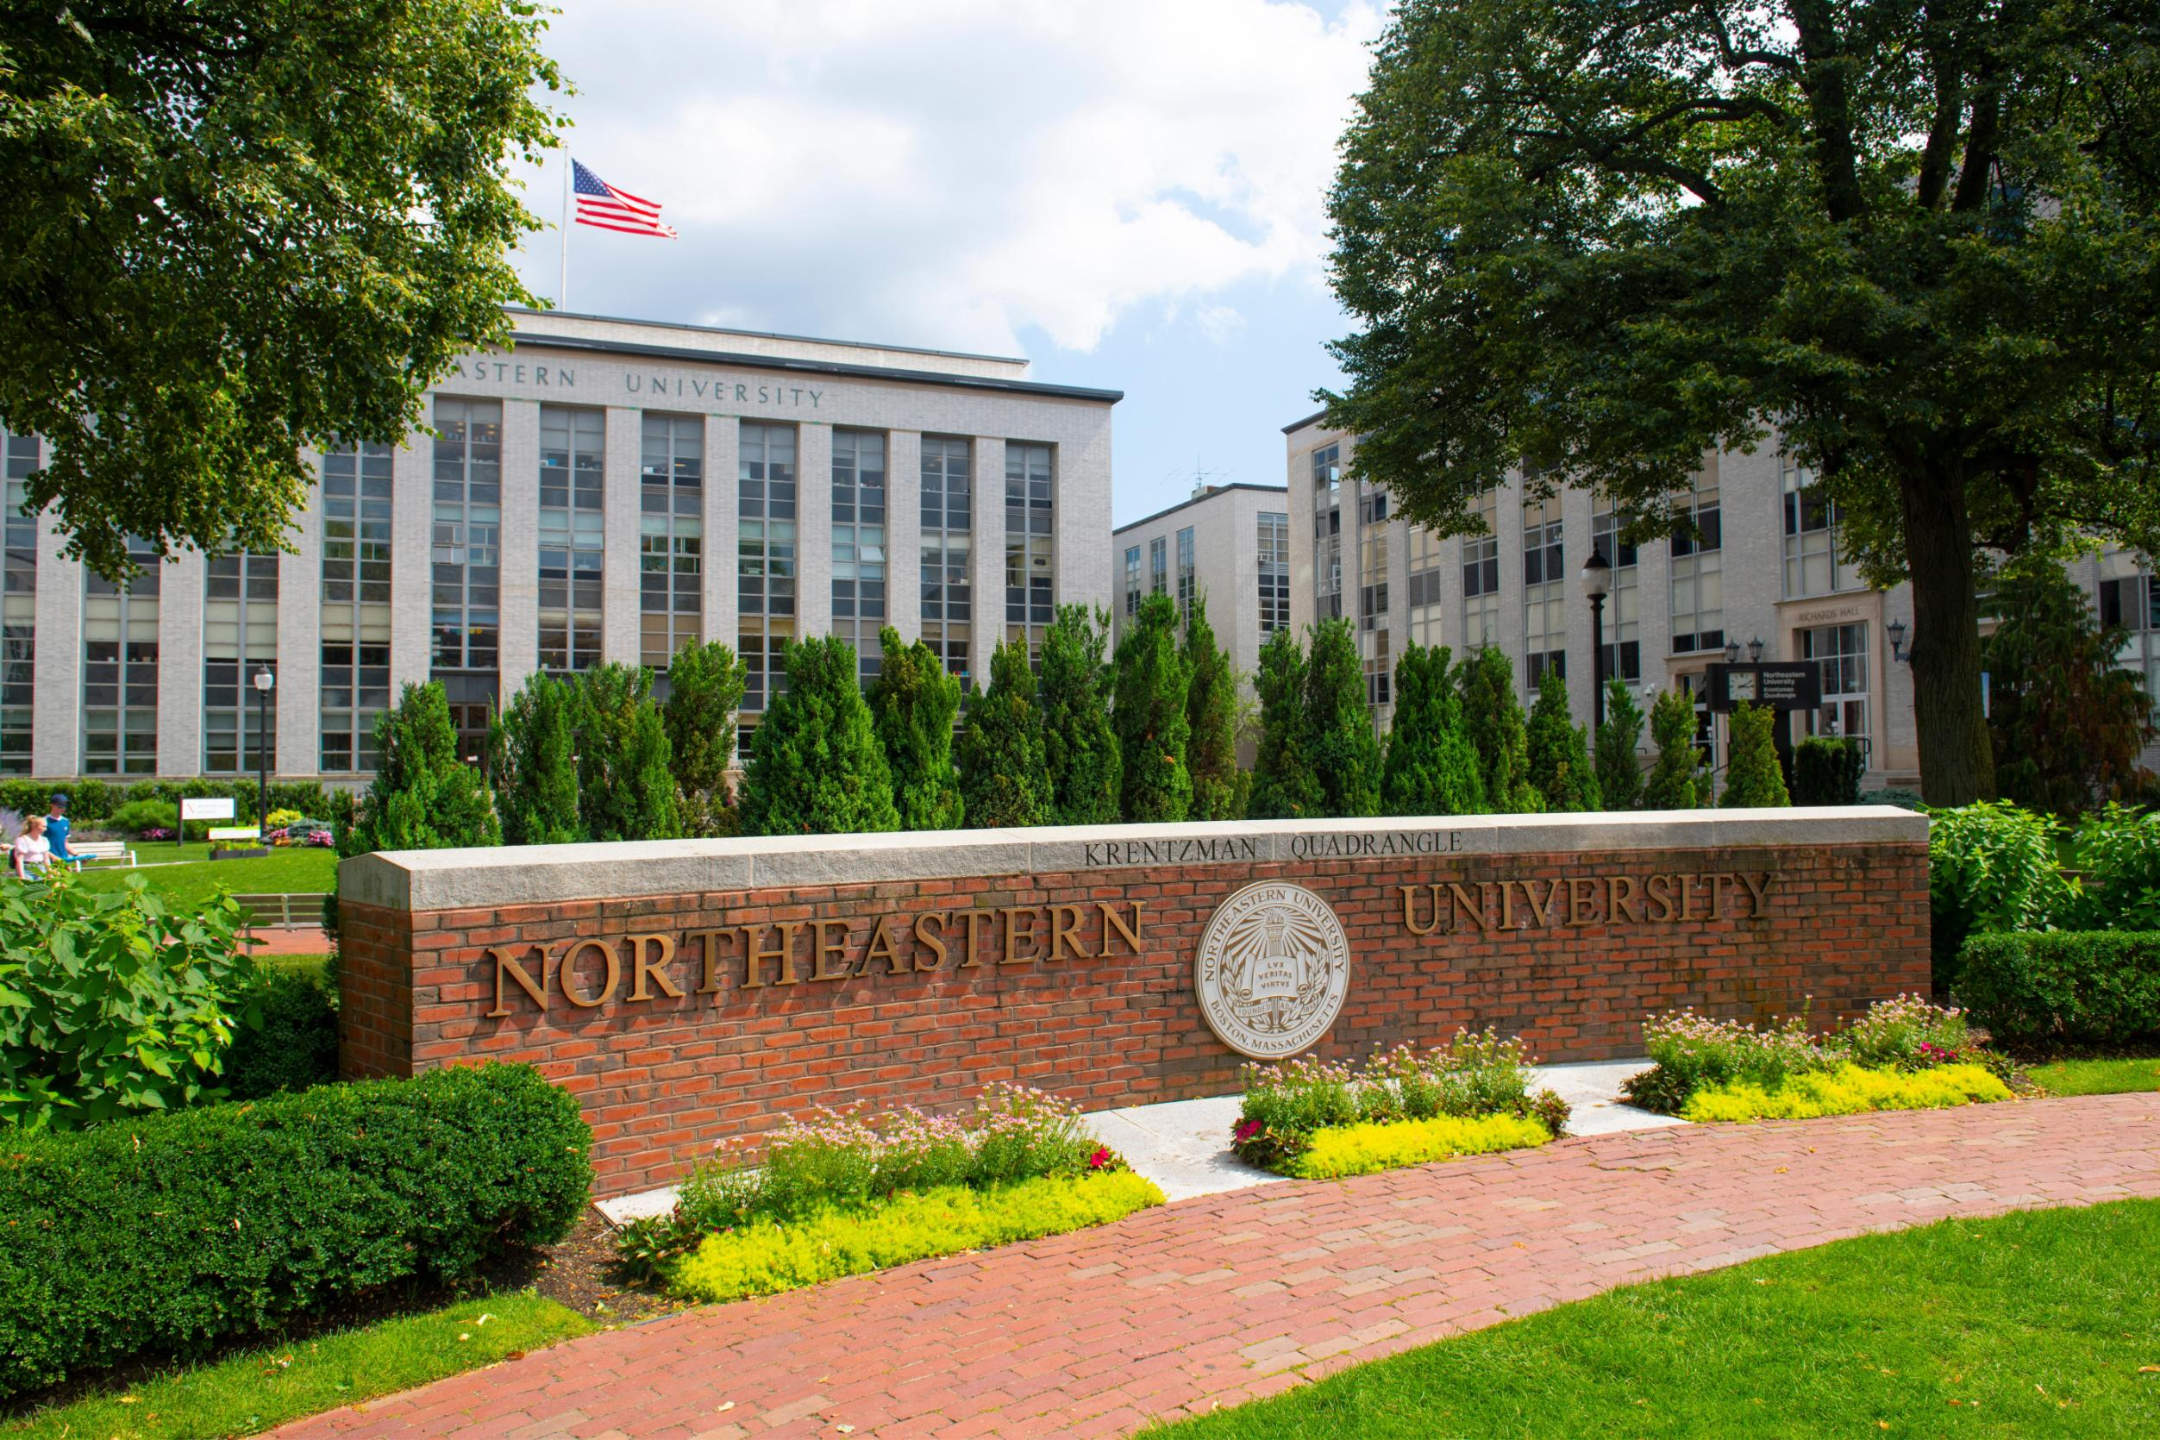

Northeastern university
Located in Boston
High housing price
Big city
Small campus
Terrible dining hall
Expensive living cost

Slide 3

Research Question
How would Chinese students in Northeastern University fit in university life?
How should Chinese students search for their university life?
How could Chinese students live in America in a more comfortable way?

Slide 4
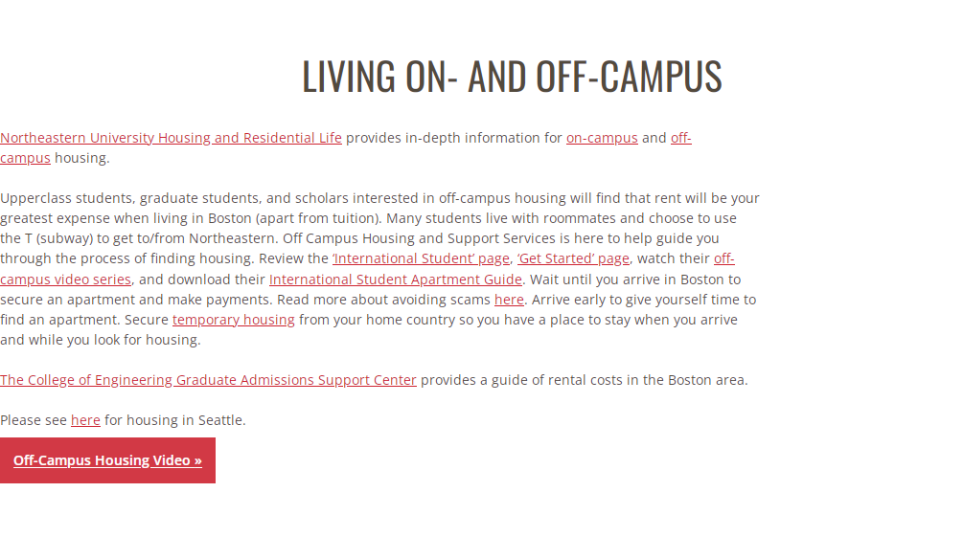
Background Research
https://international.northeastern.edu/ogs/student-support/resources/housing/

Slide 5
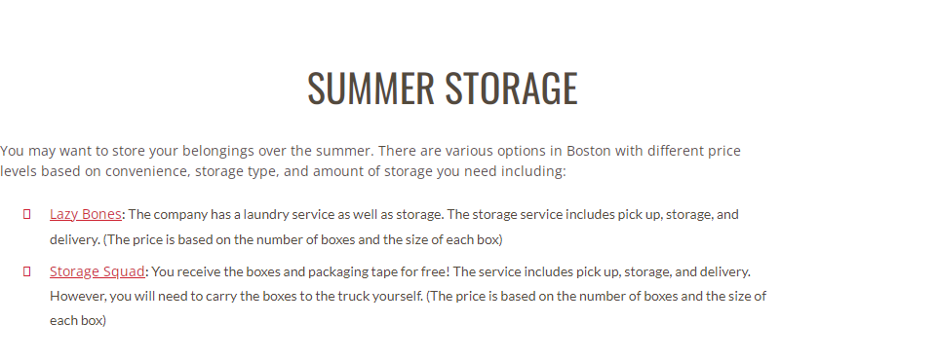
Background Research
https://international.northeastern.edu/ogs/student-support/resources/housing/

Slide 6
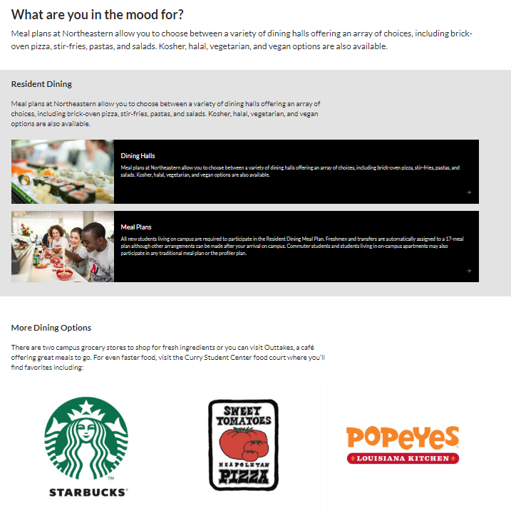
Background Research
https://admissions.northeastern.edu
/student-life/dining-on-campus/

Slide 7
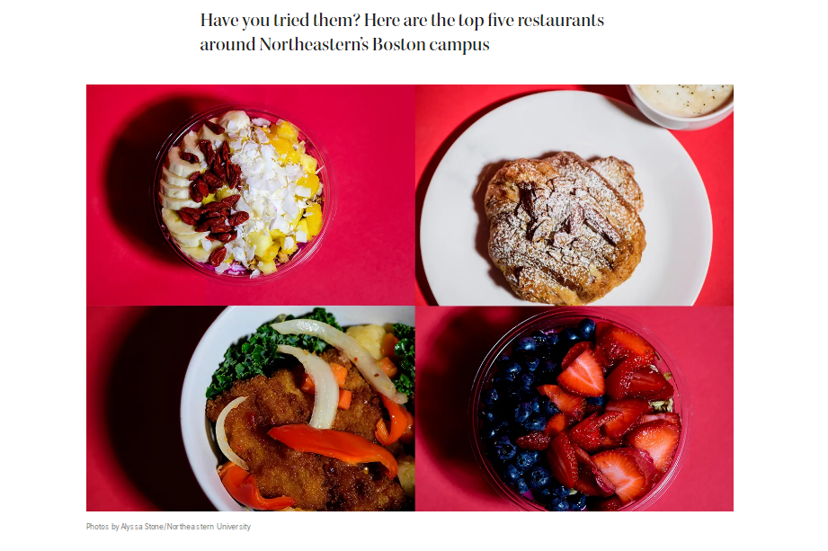
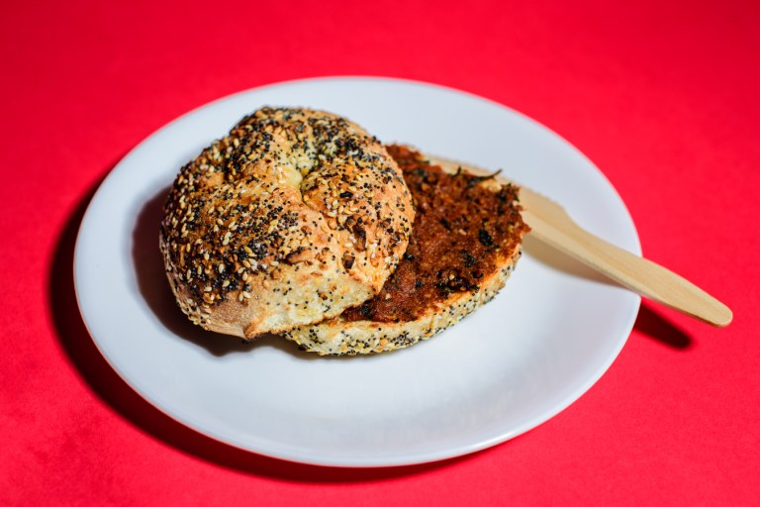
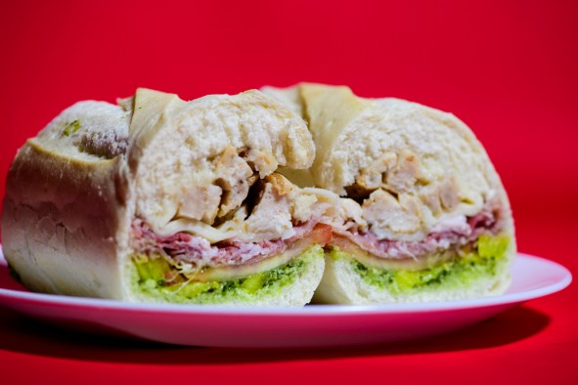
Background Research
https://news.northeastern.edu/2022/10/12/best-restaurants-near-boston-campus/

Slide 8
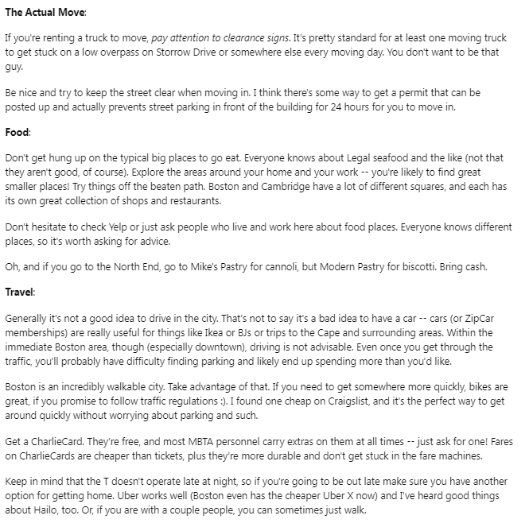
Background Research
https://www.reddit.com/r/boston/comments/1estam/moving_to_boston_what_do_i_need_to_know/

Slide 9
Problems in the Project/Suggestions for Future
Unavailability of field investigation
Lack of understanding of US social media and forums
Hard to distinguish whether information on the Internet is true or false
Different eating habits between Chinese and Americans

Slide 10
Thanks for listening

